Slide 1
TETRATHLON
Shooting

Slide 2
Tetrathlon Shooting Phase
Background
About the Guns and Pellets
Setting up a range
Ranges
Targets bought and made
Training
Resources
Safety guides

Slide 3
10 Meter Air Pistol
This is an Olympic Sport
USA Shooting needs young enthusiast
Bob Foth USA Shooting
Director of Youth Programs
Sees USPC Tetrathlon as a feeder network to the Junior Olympics and beyond
Director of Coach Development
Will arrange for a coach training seminar for 8 or more

Slide 4
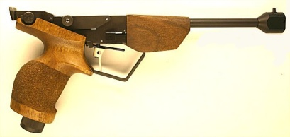
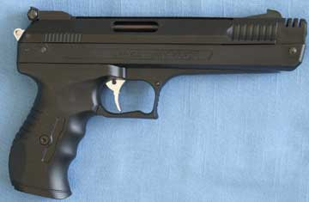
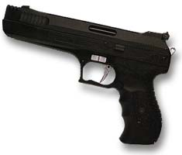
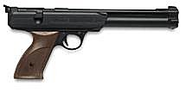
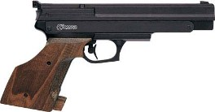
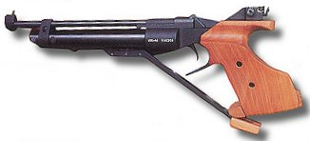
Pellet Pistols
Tau 7 Jr.
CROSMAN
Marksman 2004
Beeman P3
Daisy 747
Gamo Compact
Baikal izh46

Slide 5
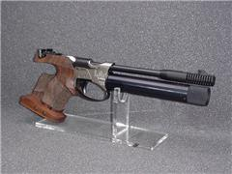
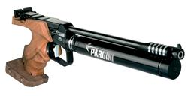
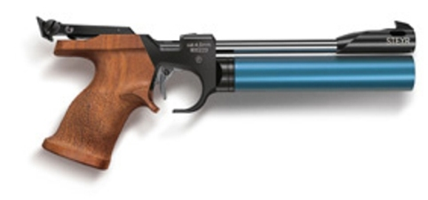
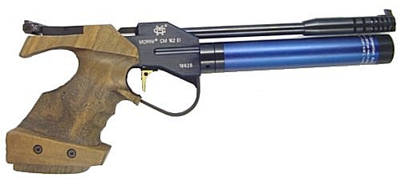
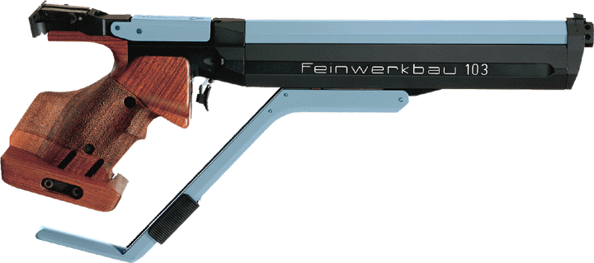
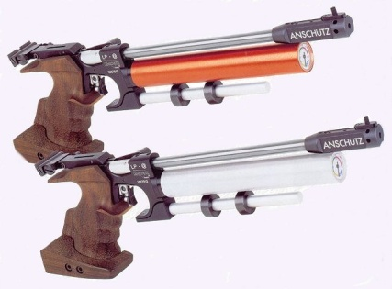
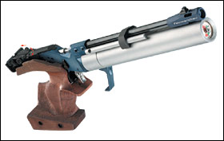
Advanced Air Pistols
Pardini
Benelli Jr
Steyr LP10
Morini
Feinwerkbau
Anschutz

Slide 6
Pellets
Not all pellets are created equal.
Caliber: .177
Type: Match grade
Wad Cutter (not pointed)
Light weight ( the heavy are for Rifles) should be 7.7 gr or less

Slide 7
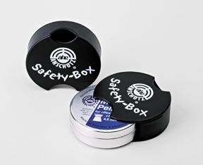
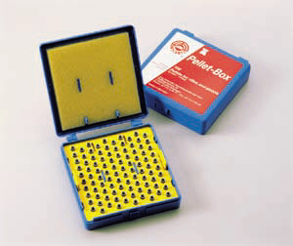
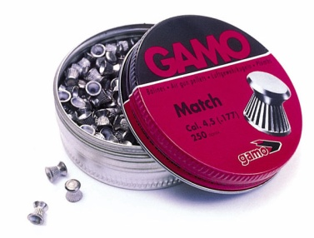
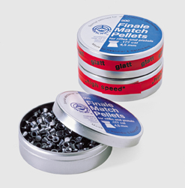
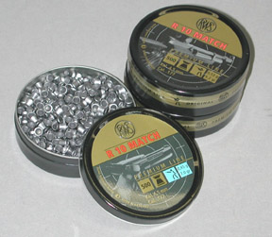
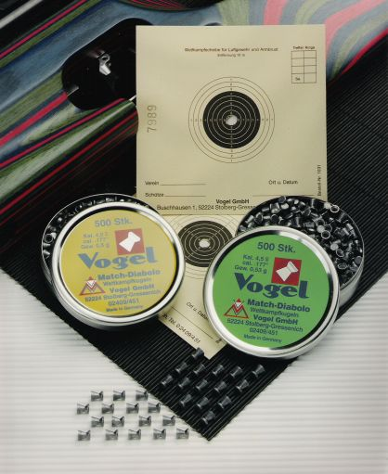
Pellets
Once you settle on a pellet stay with the same make and Model.

Slide 8
Range Setup
Target : 10 Meter Air Pistol Target
Stand Height: 1.4 M or 4ft 7in to the center of the Target
Distance: 10 Meters = 32.8 ft (33 ft)
Shooter Toe must be behind the line but the arm may extend beyond.
Distance between targets: Recommend 3 ft

Slide 11
Running The Range
More targets the better
Plan 30 Minutes Per line
40 competitors 15 targets = 3 lines = 1.5 hr to run the shoot
Gun Sharing : Needs to be factored I when setting up the lines.

Slide 14
Running the Range The Crew
Shooting Steward: (or designee) Runs the range.
Safety
Calls the Commands
Deals with broken guns
Final arbitrator on scoring
Multiple shots per hole
Too close to tell

Slide 15
Running the Range The Crew
Target Puller
At least one but two is better
Pull targets and gives them to the scorer
For range safety stands at the end of the line and reports observed issues to the Steward

Slide 16
Running the Range The Crew
Scorer
Need two
Sitting at a table away from the competitors
Tools
Calculator
Stapler or paper clips
Scoring gauge for Target shooting
Picture from
www.championshooters.com

Slide 17
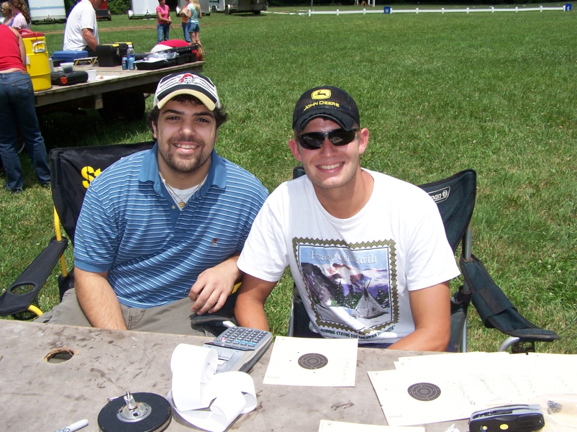

Slide 18
PRACTICE
WHERE?

Slide 19
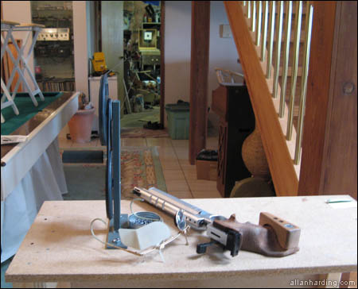
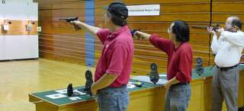
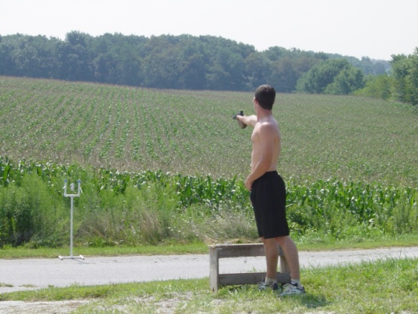
Were can we set up a practice range?
Anywhere you can find 12 meters to set up in

Slide 23
TARGET STANDS

Slide 24
Target Stands
ISSF rule is Center of target is 1.4 M from the Ground.
Home made are great and affordable
Challenge the creativity of a Parent who like to build things
PVC
Wood
Resources: ww.odcmp.com/Coaching/target_stand_plans.htm

Slide 25
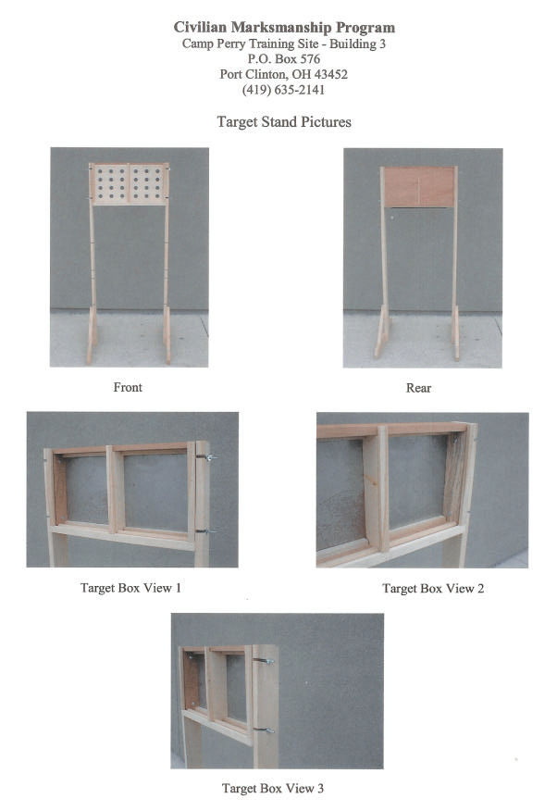

Slide 26
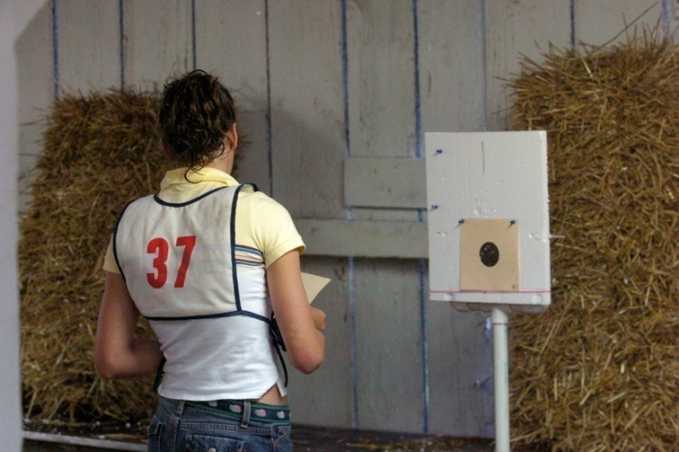
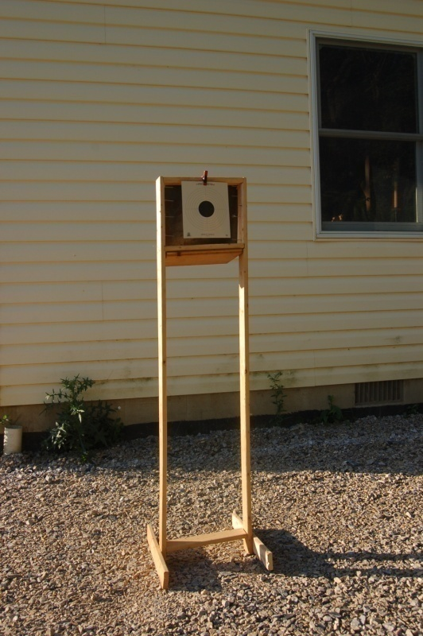
Target Stands
Home made
PVC
Wood

Slide 27
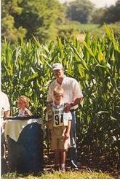
Tables

Slide 28
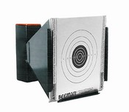
Basic Pellet Traps

Slide 29
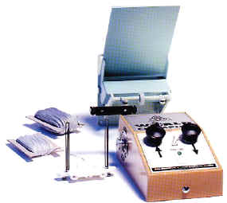
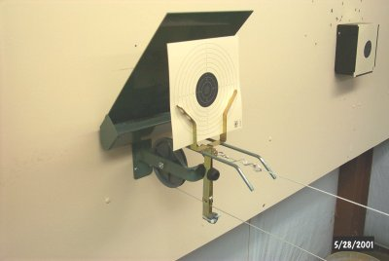
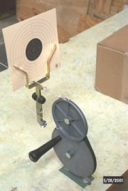
Commercial Systems

Slide 30
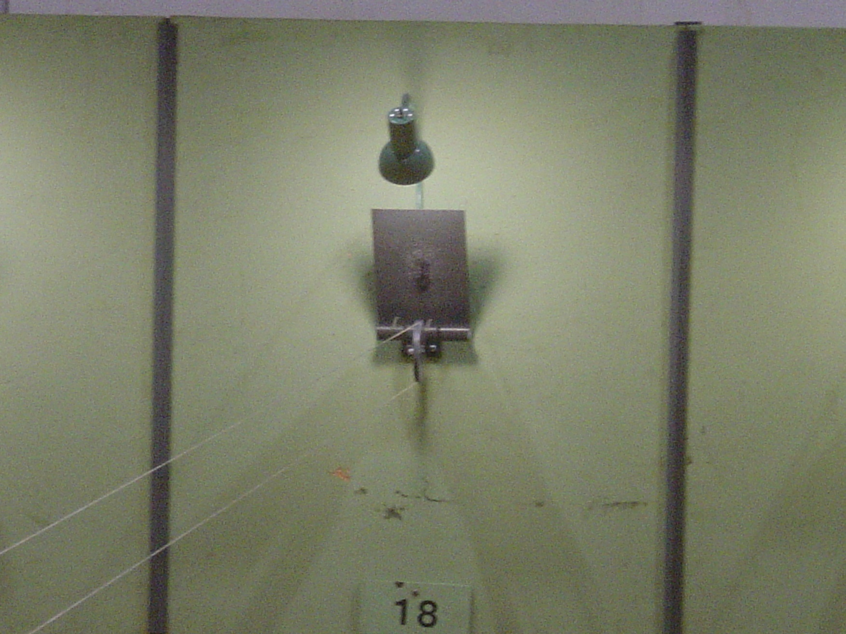

Slide 31
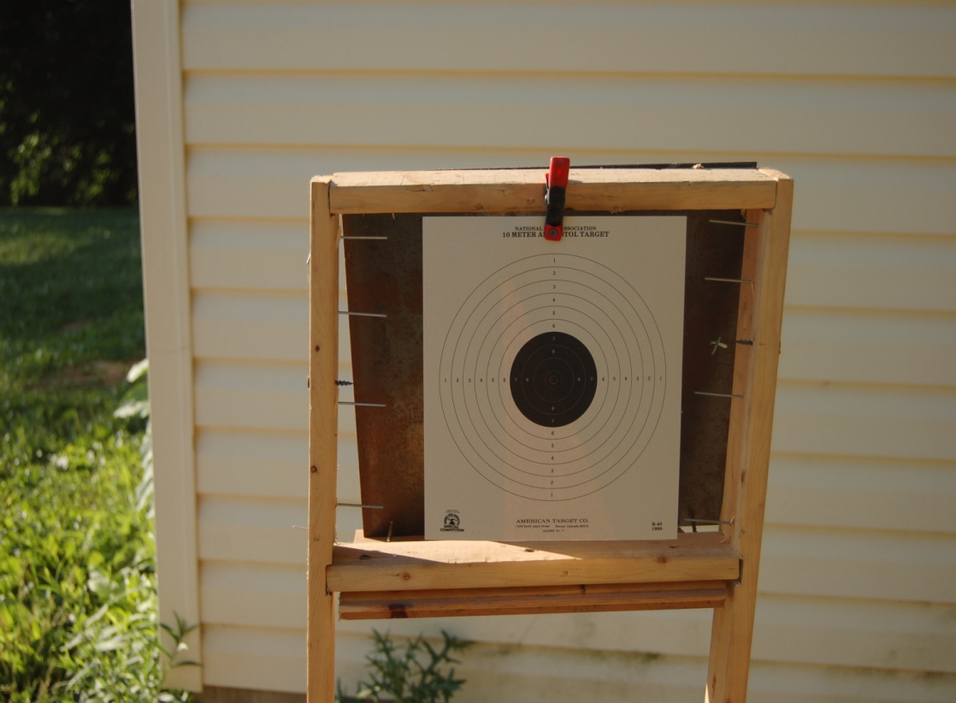

Slide 33
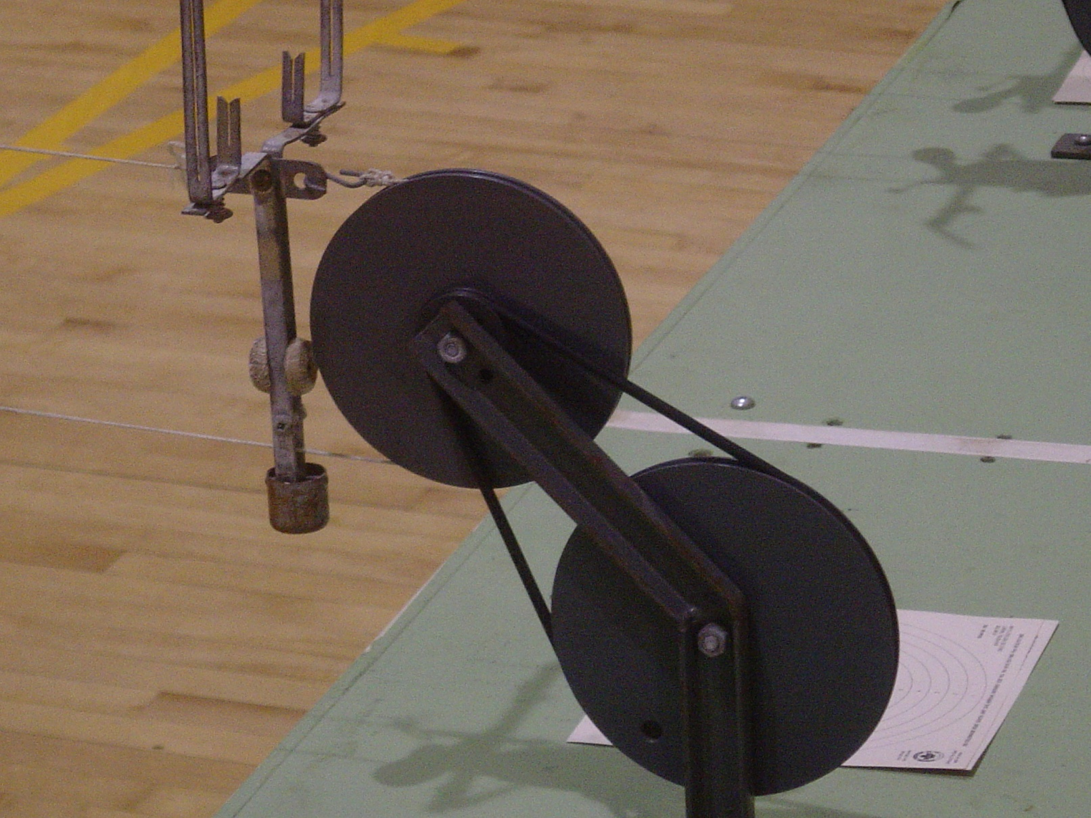
Hand crank target carrier

Slide 34
TRAINING

Slide 35
Training
Skill Sport of extreme concentration
Easiest sport to teach
Mastering the basics is all that is necessary
Not so easy to learn

Slide 36
TRAINING GUIDE
STAY CALM
FOCUS ON THE BASICS
NO MISTAKES
CONCENTRATE ON THE FRONT SIGHT
PRESS THE TRIGGER
SURPRISE SHOT BREAK
FOLLOW THROUGH
“I AM STILL LOOKING AT THE FRONT SIGHT”

Slide 37
Coaches
Look for avid Target shooter
Local Gun Club USA Shooting, NRA, CMP
33 Colleges have shooting programs is one near you?
Call USA Shooting Bob Foth and see if he knows of a quality coach near you. (contact on resources page)
Call NRA get list of clubs in your region
High School JR ROTC programs sometimes have shooting programs with good coaches

Slide 38
Coach Education Program http://www.nrahq.org/education/training/coach_schools.asp
Bob.Foth@usashooting.org, 719-866-4881
Bob Foth
Director of Youth Programs and Coach Development for USA Shooting
US Olympic Complex
1 Olympic Plaza
Colorado Springs CO 80909

Slide 39
GUNS, TARGETS, PELLETS and Stuff
http://www.compasseco.com/
http://www.airgunexpress.com/
http://www.cabelas.com
http://www.targetworldinc.com
https://www.championshooters.com/ (Target shooting equipement)
http://www.pyramydair.com
http://www.gehmann.com/
http://www.airgunsonly.com
http://www.pilkguns.com/ (Owner is a new Pony Club Dad
http://www.larrysguns.com
http://www.straightshooters.com/
http://www.6stern-meisterscheiben.com/
http://www.champchoice.com
http://www.airgunwarehouseinc.com
http://www.cheaperthandirt.com/177_ec.htm
http://www.pistoleer.com/targets/airgun/
http://www.mytargets.com/
http://www.airgunsbbguns.com
http://nealjguns.com/
http://stores.ebay.com/Olympic-Marksman-Equipment
http://www.airguns.net/comp_international_ar.php

Slide 40
Clubs and Organizations
USA Shooting (NGB for shooting)
www.usashooting.com
NRA
www.nra.org
Citizen Marksmanship Program (CMP)
http://www.odcmp.com/
4-H Shooting Sports 4-H Shooting Sports
www.4-hshootingsports.org

Slide 41
Questions

Slide 42
TETRATHLON
Shooting

